Slide 1
Simulation languages

Slide 2
Some Continuous Simulation Languages
CSMP III
Advanced Continuous Simulation Language (ACSL):
Supports textual or graphical model specification.
SimApp:
Simple simulation of dynamic systems and control systems.
Simgua:
A simulation toolbox and environment that supports Visual Basic.
VisSim:
A visually programmed block diagram language.

Slide 3
Some Discrete-Event Simulation Languages
• GPSS
• AutoMod
• eM-Plant
• Rockwell Arena
• GASP
• SimPy
• SIMSCRIPT II.5
• Simula
• Poses++
And many more……….

Slide 4
Some Hybrid Simulation Languages
AnyLogic:
Multi-method simulation tool, which supports System dynamics, Discrete event simulation, Agent-based modeling.
Simio:
A software for discrete-event, continuous, and agent-based simulation.
Modelica:
An open-standard object-oriented language for modeling of complex physical systems.
Saber Simulator:
Simulates physical effects in different engineering domains (hydraulic, electronic, mechanical, thermal, etc.).

Slide 5
CSMP III
CSMP III, or Continuous System Modelling Program IlI is an early scientific computer software designed for modelling and solving differential equations numerically. This enables real-world systems to be simulated and tested with a computer

Slide 6
CSMP III: Types of Statements
Structural statements which defines the model. They consist of FORTARN like statement and functional block designed for operations that frequently occur in a model definition.
Data statements which assign numerical value to parameters, constant and initial conditions.
Control statements which specify options in the assembly and execution of program and choice of inputs.

Slide 7

CSMP III: Structural Statements
Structural statement can make use of the operation of addition, subtraction, multiplication, division and exponentiation, using the same notation and rule as are used in FORTRAN.
If the model include the equation
Then the following statement would be used
X=6.0*Y/W+(Z-2)**2.0
There are many functional block which in addition to provide operation specific to simulation. Some of them are the exponential function, trigonometric function and function for taking maximum values.

Slide 8
CSMP III: Functional Block
There are many functional block which in addition to provide operation specific to simulation. Some of them are the exponential function, trigonometric function and function for taking maximum values.

Slide 9
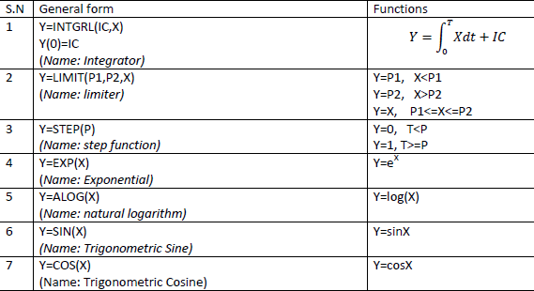
CSMP III: Functional Block

Slide 10
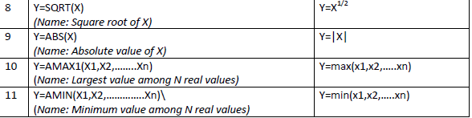
CSMP III: Functional Block

Slide 11
Data Statement
Data statements are used to set the initial values to the model parameter. For example one data statement called INCON can be used to set the initial value of integration function block.

Slide 12
CONTROL Statements
Among the control statement, TIMER is one of the control statements which specify certain time interval. For adequate accuracy, it should be small in relation to the rate at which variable change values. The following is an example
TIMER DELT=0.005, FINTIM=1.5, PRDEL=0.1
The item specified are
DELT = integration interval
FINTIM ⁼ Finish time
PRDEL ⁼ Interval, at which to print result.

Slide 13
CONTROL Statements
If printed output is required, control statements with PRINT and PRDEL are used followed by the names of variables to form the outputs.
The set of structural, data and control statements for a problem can be assembled in any order but they must be end with control statement END.

Slide 14

Example Program 1 in CSMP
The following code shows a CSMP III program for the automobile wheel suspension problem represented by
It has been coded for the case where M=2.0, F=1 and K=400. And there will be different runs with different value of D as specified

Slide 15
Example Program 1 in CSMP
TITILE AUTOMOBILE SUSPENSION SYSTEM
*
PARAM D=(5.656,16.968,39.592,56.56) //initial
*
X2DOT=(1.0/M)*(K*F-K*X-D*XDOT)
XDOT=INTGRL(0.0,X2DOT) //dynamic
X=INTGRL(0.0,XDOT)
*
CONST M=2.0,F=1.0,K=400.0
TIMER DELT=0.005,FINTIM=1.5, PRDEL=0.05 //terminal
PRINT X, XDOT, X2DOT
END
STOP

Slide 16

Example Program 2 in CSMP
Let we have a model represented by differential equation

Slide 17
Example Program 2 in CSMP
TITLE SIMPLE CSTR REACTION SIMLUATION
*
PARAM ICC=0, THETA=2.0, K=1.0, C₀=1.0,V=1.0
*
DCDT=(C₀-C)/THETA-K*C
C=INTGRL(ICC,DCDT)
*
TIMER FINTIM=15.0, DELT=0.05, PRDEL=0.5
PRINT C, DCDT
END
STOP

Slide 18
Hybrid simulation
For the most studies, the model is clearly either of continuous or discrete nature; an that is determining factor in deciding whether to use an analog or digital computer for system simulation.
However, there are times when an analog and digital computer are combined to provide a hybrid simulation. The form taken by hybrid simulation depends upon the application. One computer may be simulating the system being studied while other is providing a simulation of the environment in to which the system is to operate. It is also possible that the system being simulated is an interconnection of continuous and discrete subsystem, which can best be modeled by an analog and digital computer being linked together..

Slide 19
Hybrid simulation
High speed converters are needed to transform signal form one form of representation to another. As a practical matter, the availability of minicomputer has made hybrid simulation easier, by lowering cost and allowing computer to be dedicated to an application.
The term hybrid simulation is used generally of the case in which functionally distinct analog and digital computer are linked together for proposes of simulation.

